Slide 1
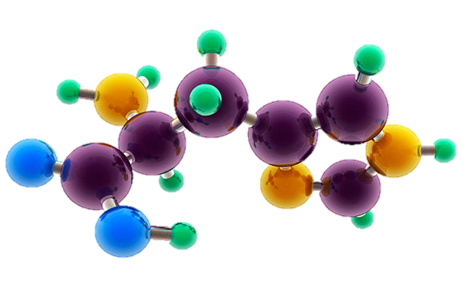
AP Chemistry Exam Review

Slide 2
Project Contributors
Big Idea 1 | Big Idea 2 | Big Idea 3
Kristie Chiscano, MD | Thomas Comey, MA | Tom Michocki, MEd
Orla Thomas, MEd | Brandie Freeman*, EdS | Suzanne Adams, MEd
Louis Casagrande, PhD | Ronald Brandt, PhD | Ali McDillon, MEd
Anne Marie Norman, MAT | Michelle Winesett, MEd | Christina Cummings MEd
 |  | Tricia Miller, MS
Big Idea 4 | Big Idea 5 | Big Idea 6
Kaleb Underwood, BA | Christine Taylor, MEd | Kate Smola, MEd
Brian Stagg, MCLFS | Liz Gosky, MEd | Jill Barker*, EdD
Bonnie Buchak, MS | Pam Kimber, MEd | Chris Sterman, MEd
Sohum Bhatt, BSE | Ouida Dunton, EdS | Glenn Arnold, MEd
 | Dave Foy, MEd | Cheryl Vanicek, MEd
Labs and Write This…
Nora Walsh, MS

Slide 3
Project Contributors, Continued
Final Editors
Paul Cohen^{*^+}, MA
Russ Maurer, PhD
Bridget Adkins*, MEd
Russ Kohnken*, PhD
Matthew Kennedy*, PhD
Dena Leggett*, PhD
Project Coordinator
Brandie Freeman, EdS Questions or Comments? Contact Brandie.Freeman@Bartow.k12.ga.us
*- AP Reader, ^ - Table Leader, ⁺ -Question Writer

Slide 4
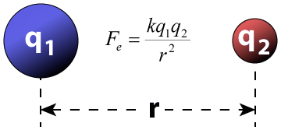
Big Idea #1
Properties of Matter

Slide 5
Ratio of Masses in a Pure Sample
Source
All elements and molecules are made up of atoms
Substances with the same atomic makeup will have same average masses
The ratio of masses of the same substance is independent of size of the substance
Molecules with the same atomic makeup (ex: H₂O) will have the same ratio of average atomic masses
H₂O₂ ratio would be different than H₂O due to the different chemical makeup
H₂O
A 4.5 gram sample of which of the following would have the greatest mass percent of oxygen?
Na₂O (molar mass = 62 g/mol)
Li₂O (molar mass = 30 g/mol)
MgO (molar mass = 40 g/mol)
SrO (molar mass = 104 g/mol)
Answer:
16/62 x 100 = 26 %
16/30 x 100 = 53%
16/40 x 100 = 40%
16/104 x 100 = 15%
Video
108 g/mol
Click reveals answer and explanation.
LO 1.1: Justify the observation that the ratio of the masses of the constituent elements in any pure sample of that compound is always identical on the basis of the atomic molecular theory.

Slide 6
Composition of Pure Substances and/or Mixtures
Source
Percent mass can be used to determine the composition of a substance
% mass can also be used to find the empirical formula
The empirical formula is the simplest formula of a substance
It is a ratio between the moles of each element in the substance
Quick steps to solve!
% to mass, mass to moles, divide by the smallest and multiply ‘til whole!)
The molecular formula is the actual formula of a substance
It is a whole number multiple of the empirical formula
Video
Click reveals answer and explanation.
LO 1.2: Select and apply mathematical routines to mass data to identify or infer the composition of pure substances and/or mixtures.

Slide 7
Identifying Purity of a Substance
Source
Impurities in a substance can change the percent composition by mass
If more of a certain element is added from an impurity, then the percent mass of that element will increase and vice versa
When heating a hydrate, the substance is heated several times to ensure the water is driven off
Then you are simply left with the pure substance and no excess water
Video
The mass percent of oxygen in pure glucose, C₆H₁₂O₆ is 53.3 percent. A chemist analyzes a sample of glucose that contains impurities and determines that the mass percent of oxygen is 49.7 percent. Which of the follow impurities could account for the low mass percent of oxygen in the sample?
n-eicosane (C₂₀H₄₂)
ribose C₅H₁₀O₅
fructose, C₆H₁₂O₆
sucrose C₁₂H₂₂O₁₁
a. has the lowest percent by mass of O
LO 1.3: The student is able to select and apply mathematical relationships to mass data in order to justify a claim regarding the identity and/or estimated purity of a substance.

Slide 8
Mole Calculations
Source
1 mole = 6.02 x 10²³ representative particles
1 mole = molar mass of a substance
1 mole = 22.4 L of a gas at STP
Video
Click reveals answer and explanation.
LO 1.4: The student is able to connect the number of particles, moles, mass and volume of substances to one another, both qualitatively and quantitatively.

